Slide 1
I. The Greatest Precept in the Kingdom
Romans 13:8-10
LOVE

Slide 2
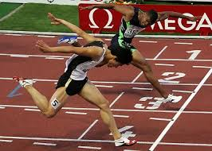
II. The Practice of the Greatest Precept in the Kingdom
I Peter 4:7-8

